Slide 1
ABGR
XI International Risk management and Insurance Seminar
“Introduction to Risk Management”
ALARYS Latin American Risk Management Foundation
(FUNDALARYS)
Javier Mirabal, Eng, ARM, AIRM, RF
FUNDALARYS- Executive Director
Sao Paulo-Brasil
October 26, 2015

Slide 2
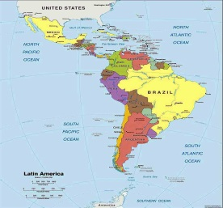
Table of Contents
Risk
Risk Management
The Risk Management Process

Slide 3
1- Risk

Slide 4
3
2
1
0
Time
Objectives to achieve
(strategic, operational, etc.)
Planning
(strategic, operational, etc.)

Slide 5
Risk
(ISO GUIDE 73:2009, Risk Management - Vocabulary)
“Effect of uncertainty on objectives”

Slide 6
3
2
1
0
Time
Objectives to achieve
(strategic, operational, etc.)
Risks
Planning
(strategic, operational, etc.)

Slide 7
Source of Risk in an Organization
Internal environment (weaknesses, strengths)
Organization
External Environment (threats, opportunities)
‘‘Events’’

Slide 8
Classification of the Risk Events
(Criteria: Type of Environment)
Culture
Infrastructure (financial, physical, etc.)
Personnel (people)
Processes
Systems (IT, etc.)
Internal Environment
Economical
Environmental
Political
Social
Technological
Legal
Others
External Environment

Slide 9
Risk Classification
Hazard
Risks
Property
Operational
Risks
People
Business Risks
Political
Financial
Risks
Market
Legal Liabilities
Processes
Credit
Counterparty
Liquidity
Economic
Social
Technological
Legal, Regulatory
People (health, injuries, death, etc.)
Gross benefit
Corporate culture
System (Technology)
Environmental

Slide 10
Risk
“Attributes”
Inherent
Risk
Risk
Tolerance
Residual
Risk
Risk
Appetite

Slide 11
2- Risk Management

Slide 12
3
2
1
0
Time
Objectives to achieve
(strategic, operational, etc.)
Risks
Planning
(strategic, operational, etc.)

Slide 13
3
2
1
0
Time
Objectives to achieve
(strategic, operational, etc.)
Risk
Management
Planning
(strategic, operational, etc.)

Slide 14
Risk Management
(ISO GUIDE 73:2009, Risk Management - Vocabulary)
“Coordinated activities to direct and control an organization with regard to risk”

Slide 15
Risk Management
Inherent
Risks
Risk Treatment
Residual
Risks
Risk Selection
Risk Universe
Criteria: Risk Appetite
Criteria: Risk Tolerance

Slide 16
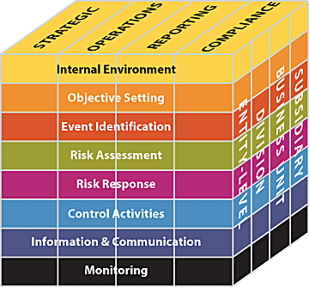
COSO-Enterprise Risk Management Integrated Framework-2004
(The Committee of Sponsoring Organizations of the Treadway Commission)

Slide 17
ISO 31000: 2009 Risk Management – Principles and guidelines
Principles
Framework
Process
Mandate and commitment
Establishing the context
Design of framework for managing risk
Risk assessment
Risk identification
Communication and consultation
Monitoring and Review
Continual improvement of the framework
Implementing risk management
Risk Management Principles
Risk analysis
Risk evaluation
Monitoring and review of the framework
Risk treatment
17

Slide 18
3- The Risk Management Process

Slide 19
Risk Management
Inherent
Risks
Risk Treatment
Residual
Risks
Risk Selection
Risk Universe
Criteria: Risk Appetite
Criteria: Risk Tolerance

Slide 20
Risk Transformation
(criteria: Risk Appetite & Risk Tolerance)
Inherent Risk
Residual Risk

Slide 21
COSO-Enterprise Risk Management Integrated Framework-2004
(The Committee of Sponsoring Organizations of the Treadway Commission)
Risk Management Process

Slide 22
ISO 31000: 2009 Risk Management – Principles and guidelines
Principles
Framework
Risk Management Process
Mandate and commitment
Establishing the context
Design of framework for managing risk
Risk assessment
Risk identification
Communication and consultation
Monitoring and Review
Continual improvement of the framework
Implementing risk management
Risk Management Principles
Risk analysis
Risk evaluation
Monitoring and review of the framework
Risk treatment
22

Slide 23
Risk Management Process
Monitoring & Review (Continuous Improvement)
Event
Identification
Establishing
the
context
Risk
Assessment
Risk
Treatment
(Controls)
Controls
Implementation
Communication and Consultation

Slide 24
Control (ISO GUIDE 73:2009, Risk Management - Vocabulary)
“Measure or action that modifies risk”

Slide 25
Control (Classification)
Type of Control | Probability | Impact
Risk Control (Prevention) | X
Risk Mitigation (Reduction) |  | X

Slide 26
The End

